Slide 1

Parenting Styles
Chapter 16

Slide 2
parenting Styles
Origins & Building Blocks
Types of Parenting Styles
Effects on Children
Contextual Influences

Slide 3
Origins of parenting Styles
Diana Baumrind
  1970’s-1990’s
  Preschool aged children
  Continues throughout current research

Slide 4
Elements of parenting
Parental Warmth
  Acceptance/Responsiveness: support, affection, & encouragement
Parental Control
  Demandingness: monitored, disciplined, & regulated

Slide 5
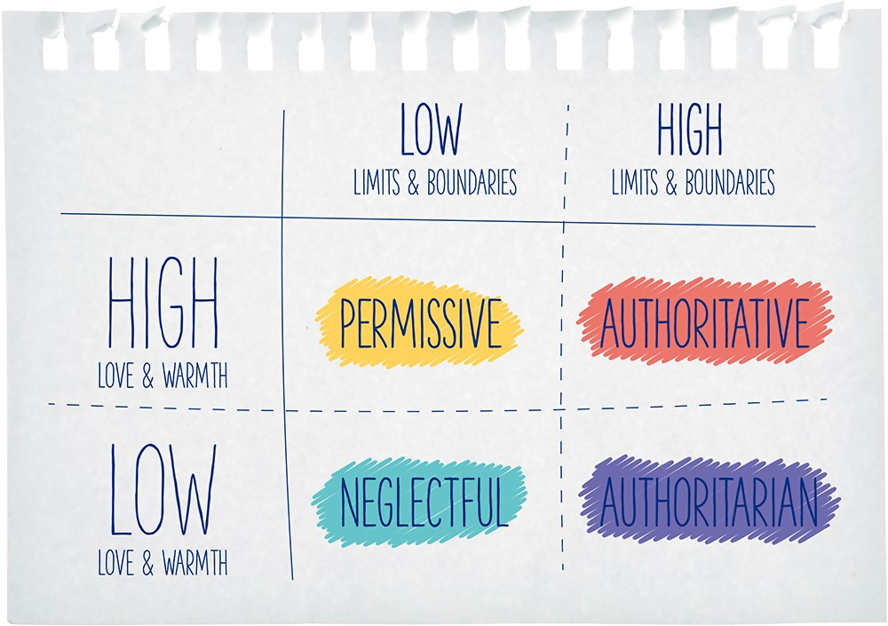
Parenting styles
Parental Warmth
  Acceptance/Responsiveness: support, affection, & encouragement
Parental Control
  Demandingness: monitored, disciplined, & regulated

Slide 6


Authoritative Parenting
Accepting of the child, displays frequent affection
High standards for behavior
Consistent discipline & limit setting
Reason rather than force
Listens to child’s point of view

Slide 7
Authoritative Parenting
Talkative parents
Focus on autonomy
Expectations are developmentally appropriate
Goal to raise self-reliant child

Slide 8

Authoritarian parenting
Shows little warmth, may actively reject
High standards for behavior
Expects strict obedience
Harsh, punitive discipline
Does not listen to child’s point of view

Slide 9
Authoritarian parenting
Does not encourage autonomy
Child should accept rules without explanation
Cold & demanding relationship

Slide 10

permissive parenting
Highly accepting, frequent expressions of affection
Undemanding regarding child’s behavior
Lax rules, inconsistent discipline
Reason rather than force
Encourages child to express point of view

Slide 11
permissive parenting
Believe control infringes on child’s freedom
Parents are resource for child
Focus is on raising a happy child

Slide 12

Uninvolved parenting
Emotionally detached, withdrawn
Undemanding regarding child’s behavior
May be Neglectful

Slide 13
Uninvolved parenting
Minimal time & energy spent on the child
Parents are uninterested in the child
Family is structured around the parents’ needs

Slide 14
Parenting style quiz
Parenting Styles
Video Clip Quiz

Slide 15
Parenting styles
Parental Warmth
  Acceptance/Responsiveness: support, affection, & encouragement
Parental Control
  Demandingness: monitored, disciplined, & regulated

Slide 16
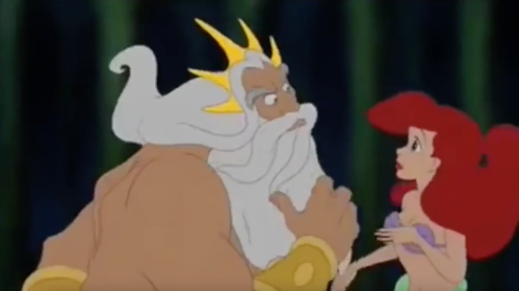
Parenting styles
Parental Warmth
  Acceptance/Responsiveness: support, affection, & encouragement
Parental Control
  Demandingness: monitored, disciplined, & regulated

Slide 17

Parenting styles
Parental Warmth
  Acceptance/Responsiveness: support, affection, & encouragement
Parental Control
  Demandingness: monitored, disciplined, & regulated

Slide 18
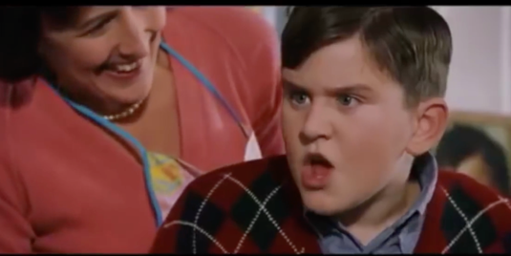
Parenting styles
Parental Warmth
  Acceptance/Responsiveness: support, affection, & encouragement
Parental Control
  Demandingness: monitored, disciplined, & regulated

Slide 19

Why Authoritative Parenting is best
  Most positive child outcomes
  Children tend to be curious, self-confident, and well behaved
  Performs well in school, popular with peers, high self-esteem
  Low likelihood of engaging in problem behaviors (drug use)

Slide 20

Authoritarian Parenting
Negative Outcomes
  Anxious, easily upset, & low self-confidence
  More likely to react with anger and aggression
  Higher risk of conduct problems, depression and anxiety

Slide 21

Permissive Parenting
Negative Outcomes
  Impulsive, immature, disobedient
  Overly dependent & low persistence
  Difficulties in school

Slide 22
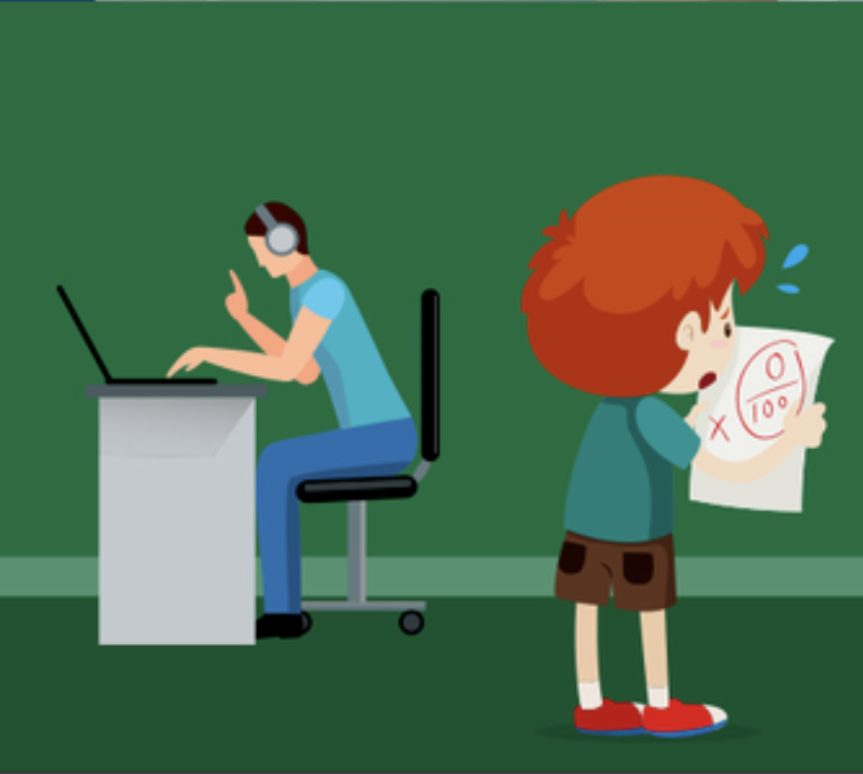
Uninvolved Parenting
Negative Outcomes
  Insecure attachment
  Low social competence
  Higher risk of substance abuse, delinquency, & mental health problems

Slide 23
Contextual Influences
Most research was done with European American, middle-class, families
  Varies by context
  Varies by ethnicity

Slide 24
Contextual Influences
Authoritarian style more common in subgroups
  African American
  Asian American
  Chinese families
  Southern & Midwestern United States

Slide 25
Contextual Influences
Parenting Roles
  Primarily focused on mothers
  Fathers increasing role in child care
  Can also vary by culture

Slide 26
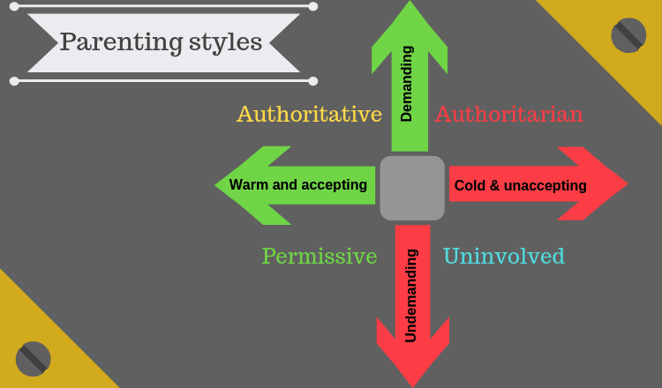
Parenting styles

